Slide 1
Binary Search

Slide 2
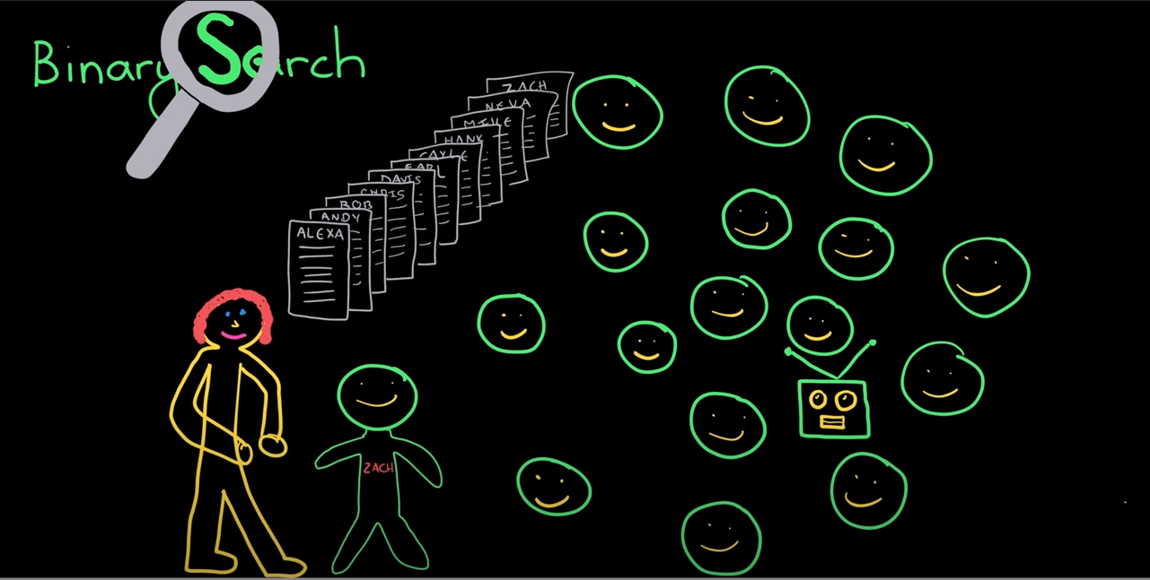

Slide 3
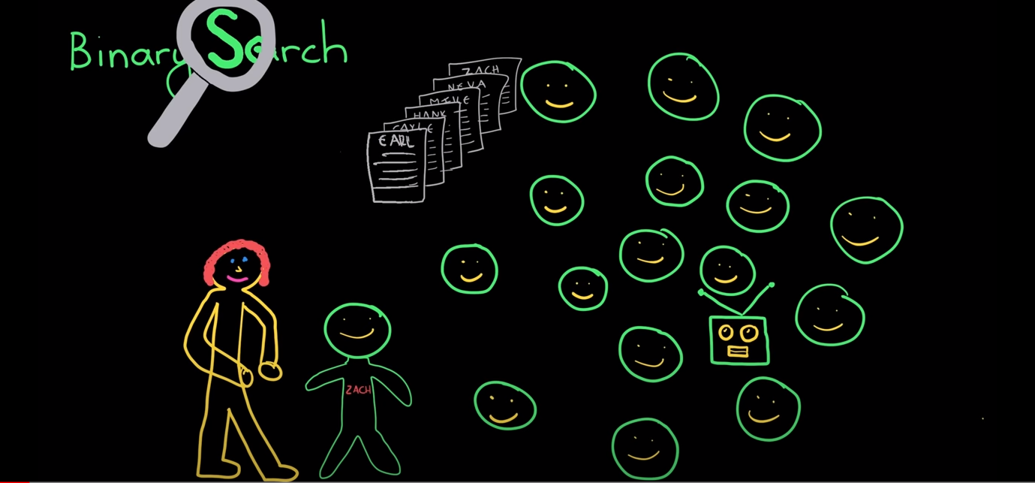

Slide 4
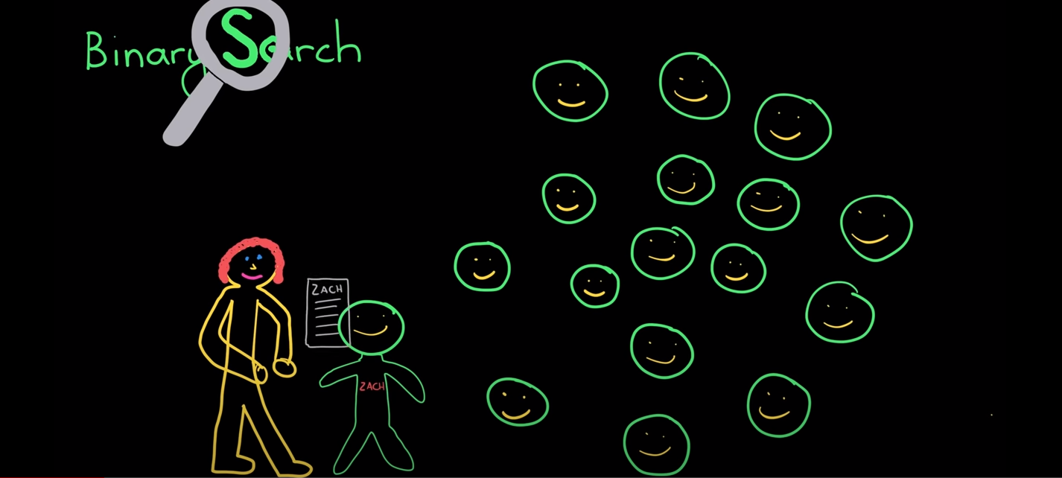

Slide 5
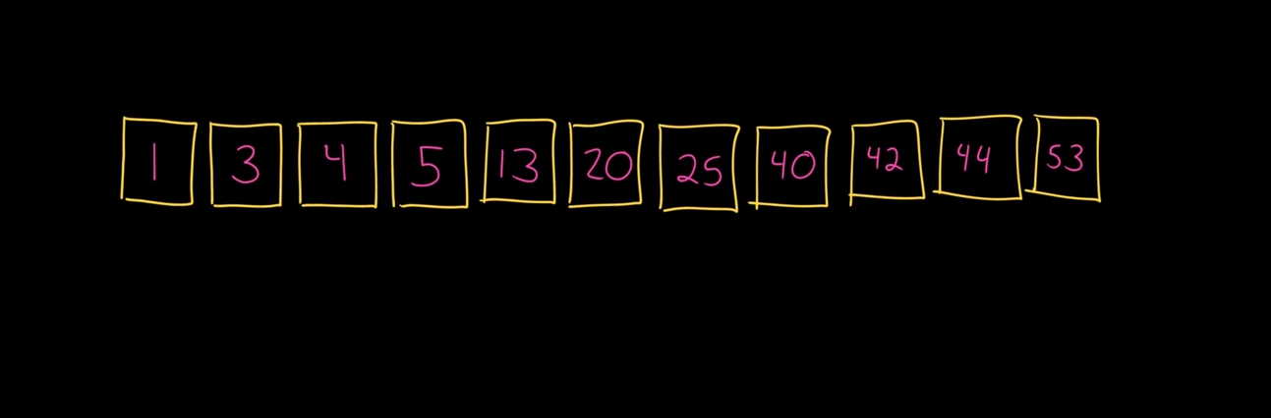
Running Example

Slide 6
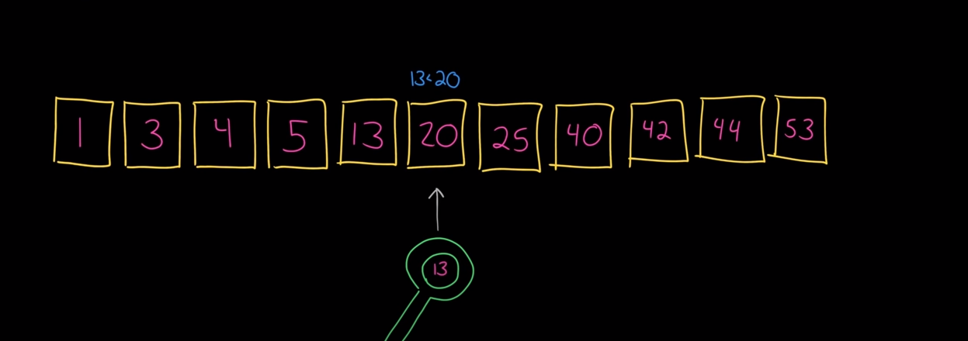

Slide 7
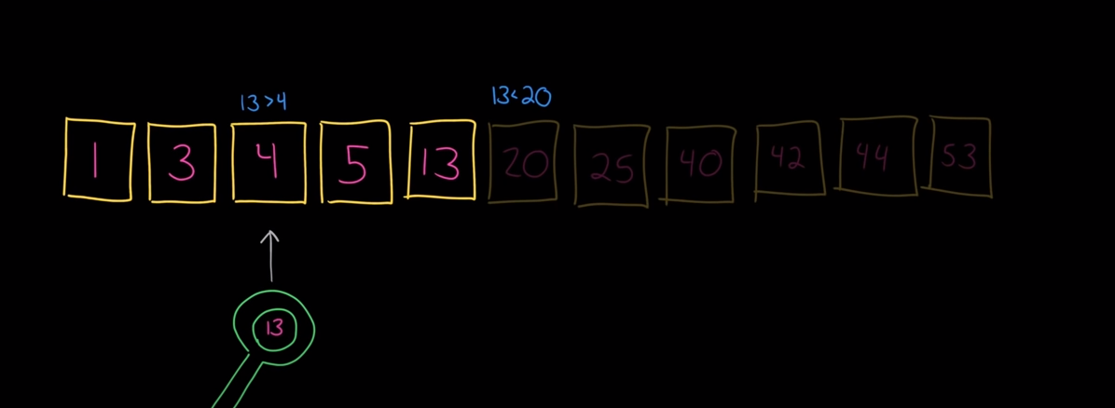

Slide 8
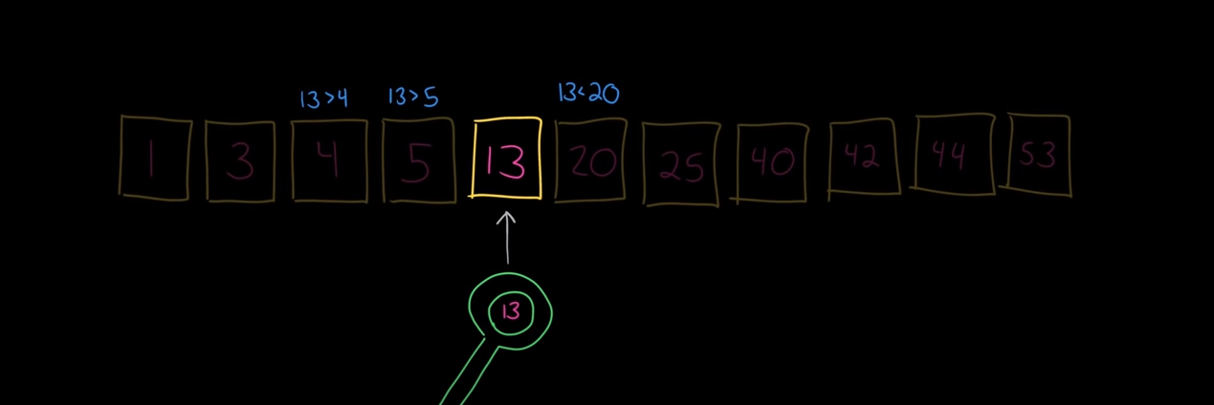

Slide 9
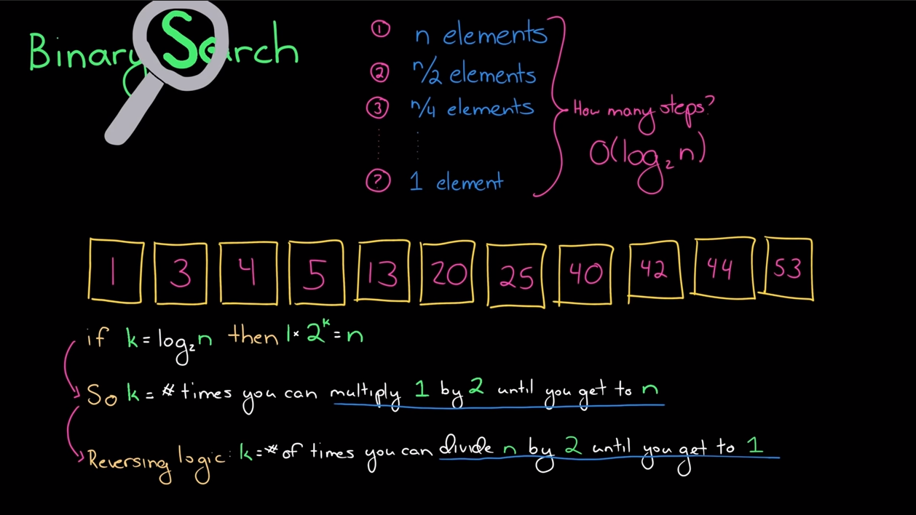
How Fast Is This Algorithm?

Slide 10
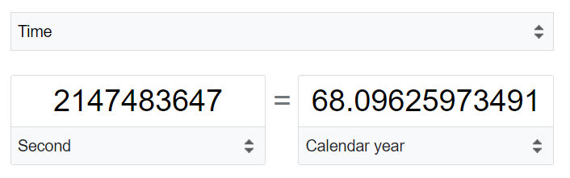

Take a Moment to Appreciate Log n
N = 2,147,483,647 (which is MAX value an integer can hold)
Binary Search O(log n) V.S Linear Search O(n) 9.33 seconds V.S. 68 years

